Slide 1

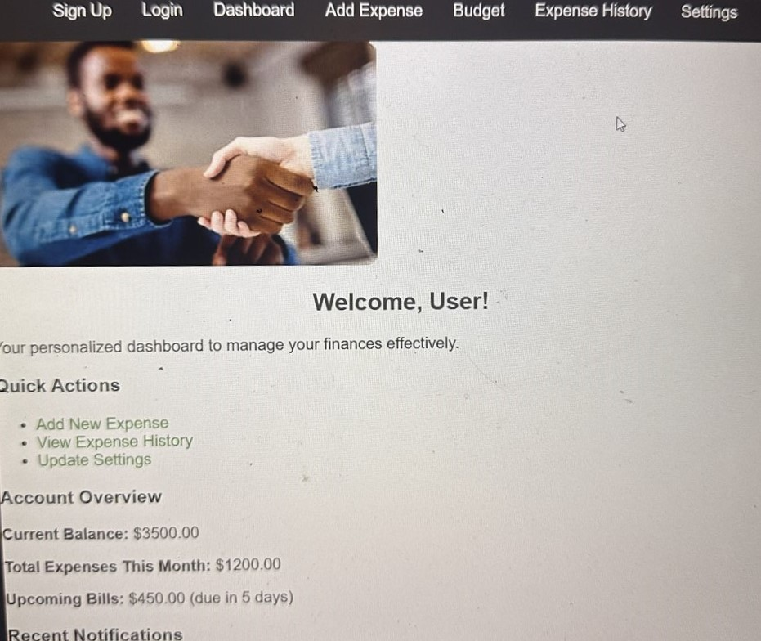
CLUTCH FUNDS
Dandre Victor, Antonio Alston, Janielle Olugbade
Florida A&M University
INTRODUCTION
MATERIALS AND METHODS
CONCLUSION
Project Management Tools: Utilized GitHub for version control and collaboration, allowing for efficient code management and tracking changes throughout the development process. This platform enabled seamless collaboration among team members and facilitated code reviews, ensuring code quality and integrity.
Integrated Development Environment (IDE): Employed IntelliJ IDEA, a powerful IDE for Java, to develop the back-end functionalities of Clutch Funds. IntelliJ’s features such as code completion, debugging tools, and integrated testing frameworks streamlined the coding process and enhanced productivity.
Prototyping: Developed wireframes and mockups utilizing tools like Adobe XD or Figma to visualize the app’s user interface and navigation flows.
Back-End Database Management: Implemented Firebase as the back-end solution for user data storage and authentication. Firebase’s real-time database feature allowed for seamless data synchronization across different devices, while its authentication services ensured secure user login and data protection. Firebase Analytics was also utilized to gain insights on user behavior and app usage.
Clutch Funds stands to make a significant impact on the financial wellbeing of its users by providing a simple and effective tool for expense tracking and budgeting. The clear and user-friendly interface addresses common challenges associated with personal finance management, making it an appealing choice for young professionals and students. Future iterations of the app will focus on expanding its capabilities, including the integration of additional features to enhance user engagement and satisfaction. By promoting better financial practices, Clutch Funds aims to foster a more financially literate and responsible user base.
While living in an era with living costs going up and the need to understand money is becoming more important, Clutch Funds is a simple app to help you track your expenses. Made for everyone specifically young professionals and students. It helps you manage your spending with easy-to-use tracking, budgeting tools, and helpful insights. Clutch Funds helps you see where your money is going and encourages smart spending and reaching your financial goals.
OBJECTIVES
AKNOWLEDGMENTS OR CONTACT
- Create an easy-to-use platform so people can track their expenses without any hassle.
- Offer all the tools needed for budgeting to help with smart financial planning.
- Give users useful insights and analytics to make better money decisions.
- Make sure the app is secure and user-friendly for everyone, no matter their financial knowledge.
- Plan to add cool features like automatic expense categorization and linking with digital banking services in future updates.
We would like to thank Professor Coote for her invaluable guidance and support during the course of this project.
RESULTS
As a result of the development process, Clutch Funds successfully incorporates essential features that include:
- Seamless user registration and authentication, ensuring user data security.
- A versatile expense logging system that allows users to categorize expenses and view their spending history.
- A dynamic dashboard providing monthly spending summaries and insights into spending habits.
Positive user feedback highlighting the app's ease of use, aesthetic design, and overall effectiveness in managing personal finances.
2 app features: Alerts, Notifications, and Dark mode On/Off.

